Slide 1
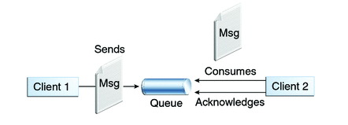

Spring + JMS + ActiveMQ example with @JmsListener & @EnableJms
We will see the alternative to javax.jms.MessageListener which allows us to create MessageListeners using plain POJO’s, thanks to Spring’s very own @JmsListener, used in combination with JmsListenerConnectionFactory and @EnableJMS. Let’s get started.
Queues [point-to-point]:
Queue’s are based on point-to-point messaging model where messages are sent to a queue.
Each message has exactly one sender and one receiver.
Message is guaranteed to be delivered to only one receiver.
SpringJMSProducer Application
SpringJMSConsumer Application

Slide 2
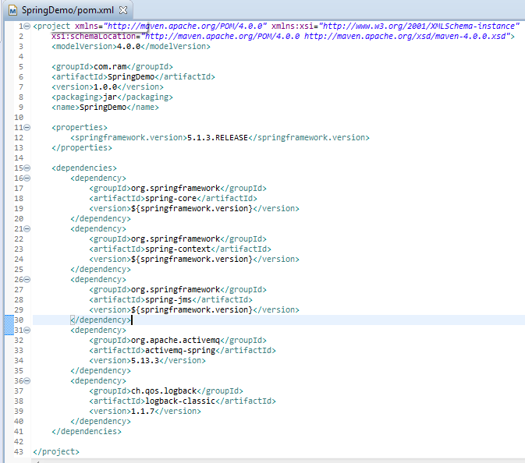
SpringJMSProducer Application

Slide 3
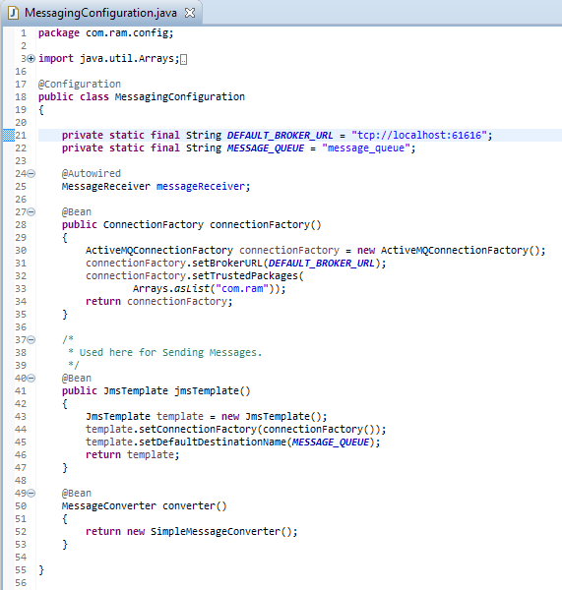
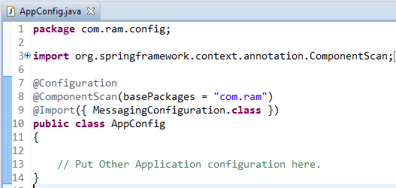
SpringJMSProducer Application
JmsTemplate : JmsTemplate provides an abstraction which hides all the complexities of JMS communication.
Without JmsTemplate, you will be forced to create connections/sessions/MessageProducers/MessageConsumers and catch all the nasty exception platform may throw.
With JmsTemplate ,you get simple API’s to work with , and spring behind-the-scenes take care of all the JMS complexities. It takes care of creating a connection, obtaining a session, and finally sending [as well as synchronous receiving] of message. We will be using JmsTemplate for sending the message.
Do note that JmsTemplate also provides possibilities for receiving message but that is synchronous[blocks the listening application], and usually not preferred when asynchronous communication is possible.

Slide 4
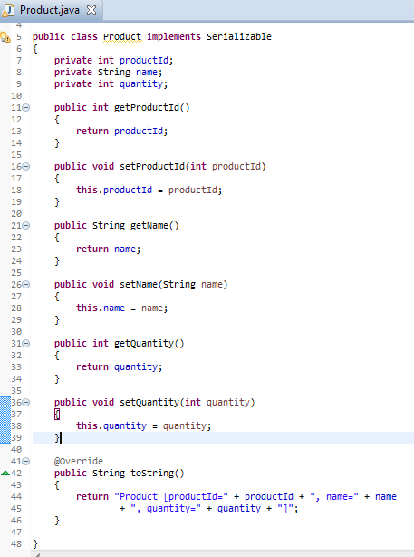
SpringJMSProducer Application

Slide 5
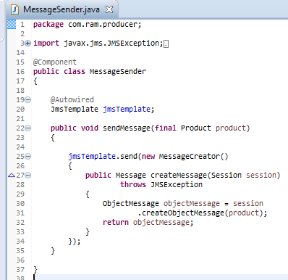
SpringJMSProducer Application

Slide 6
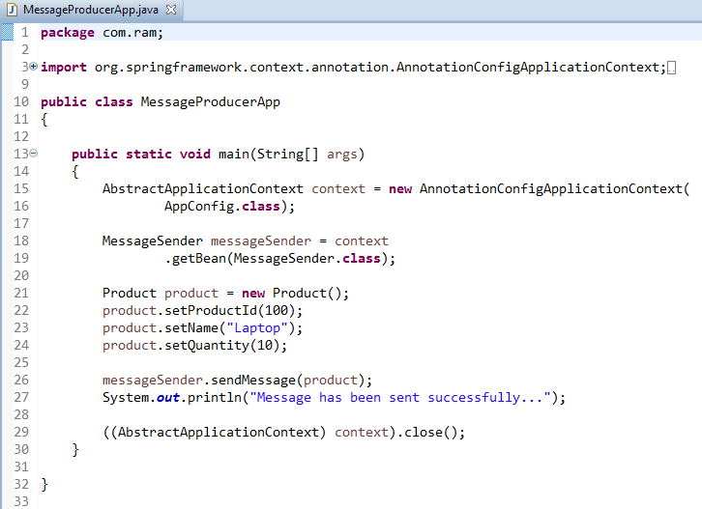
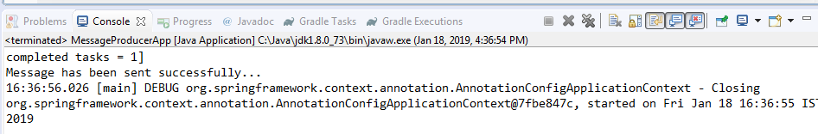
SpringJMSProducer Application

Slide 7
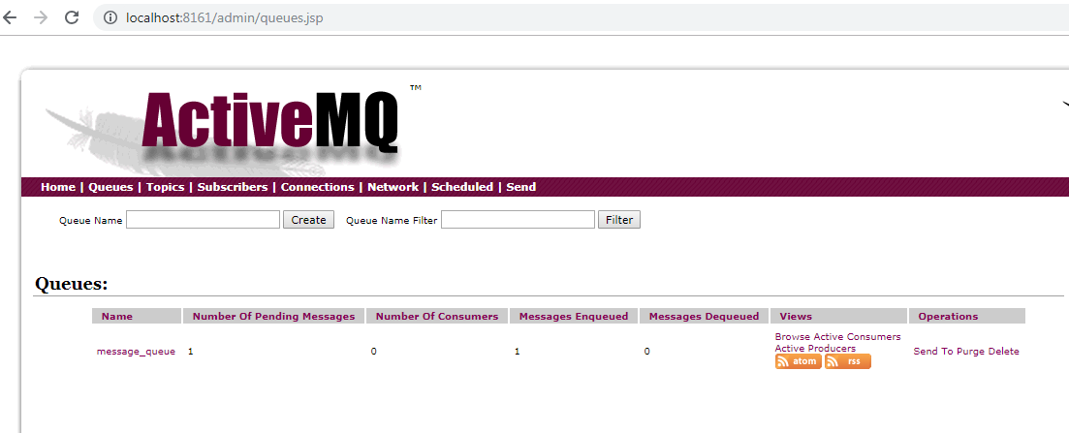
SpringJMSProducer Application

Slide 8
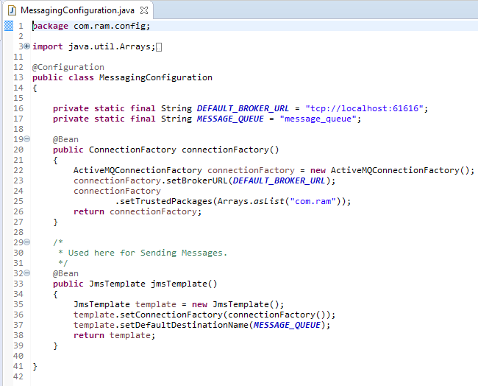
SpringJMSConsumer Application

Slide 9
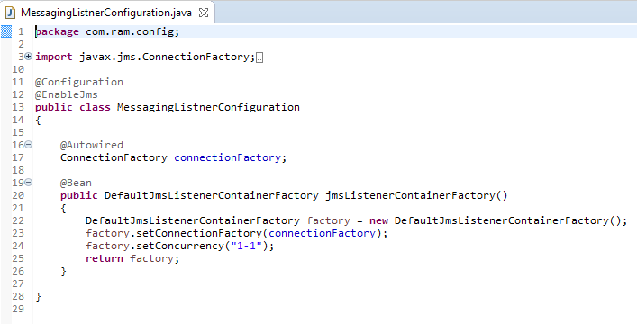
SpringJMSConsumer Application
1. Configure a message-listener-container [ with JmsListenerContainerFactory] : which listens on a destination [can be the one used with @JmsListener] and when any message arrives on this destination, it retrieved that message and passes to the bean annotated with @JmsListener for that destination.
2. Use @EnableJms which enables detection of JmsListener annotations on any Spring-managed bean in the container.
DefaultJmsListenerContainerFactory is a JmsListenerContainerFactory implementation to build a regular DefaultMessageListenerContainer. You can configure several properties. At the very least, it needs a connection factory. Additionally, we have specified the concurrency [max number of concurrent users/consumers] using setConcurrency(“lowwe-upper”). You can also use setConcurrency(“upper”) which means lower will be 1.

Slide 10
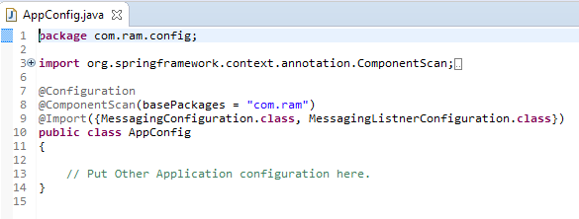
SpringJMSConsumer Application

Slide 11
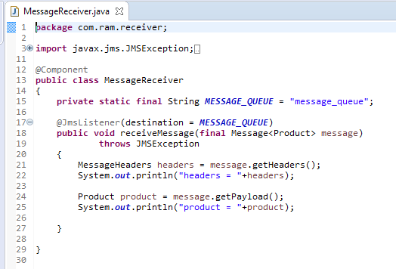
SpringJMSConsumer Application
Here is a POJO, which does not implement javax.jms.MessageListener, just annotated with @JmsListener which marks a method to be the target of a JMS message listener on the specified destination()

Slide 12
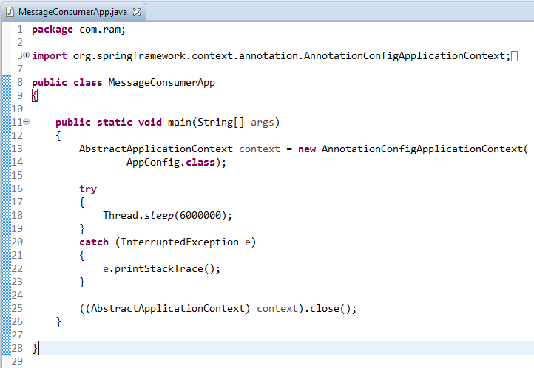
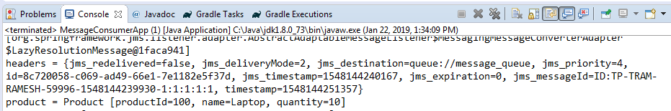
SpringJMSConsumer Application

Slide 13
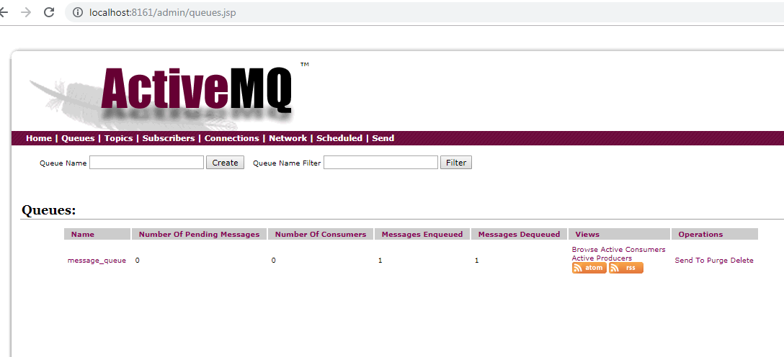
SpringJMSConsumer Application

